Slide 1
Indicator Variables
Part 1
BUAN / MECO 6312
Dr. Moran Blueshtein
University of Texas – Dallas.

Slide 2
Indicator Variables
Consider a model to predict the sale price of a house as a function of its characteristics:
size
number of bedrooms
Age
Location
Size, number of bedrooms and age are quantitative variables. However, Location is a qualitative variable.

Slide 3
Indicator Variables
How do we account for location, which is a qualitative variable?
Indicator variables (or dummy variables) can take two values, one or zero, to indicate the presence or absence of a characteristic or to indicate whether a condition is true or false.

Slide 4
Indicator Variables
Generally, we define an indicator variable D as:
So, for location, we would have:

Slide 5
Indicator Variables
Intercept Indicator Variables
Adding our indicator variable to our model
The value D = 0 defines the reference group, or base group

Slide 6
Indicator Variables
Intercept Indicator Variables
Adding an indicator variable causes a parallel shift in the relationship by the amount δ
This is called intercept indicator variable, or an intercept dummy variable

Slide 7
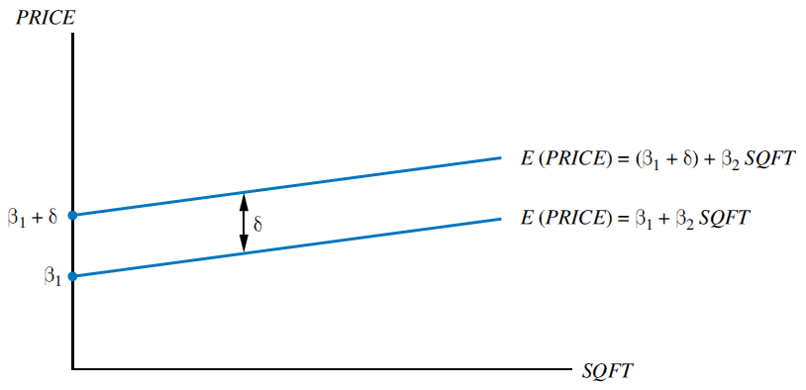
Indicator Variables
An intercept indicator variable
Intercept Indicator Variables

Slide 8
Indicator Variables
Choosing the Reference Group
How to choose the reference group (or base group)
We could pick any base
For example:

Slide 9
Indicator Variables
Choosing the Reference Group
Then our model would be:
Earlier we had:
Therefore,

Slide 10
Indicator Variables
Choosing the Reference Group
Suppose we included both D and LD:
The variables D and LD are such that D + LD = 1
we have created a model with exact collinearity
By including only one of the indicator variables the omitted variable defines the reference group and we avoid the problem.

Slide 11
Indicator Variables
Slope Indicator Variables
Suppose we specify our model as:
The interaction variable SQFT x D is the product of house size and the indicator variable
This is called a slope-indicator variable or a slope dummy variable, because it allows for a change in the slope of the relationship

Slide 12
Indicator Variables
Slope Indicator Variables
Now we can write:
The slope can be expressed as:

Slide 13
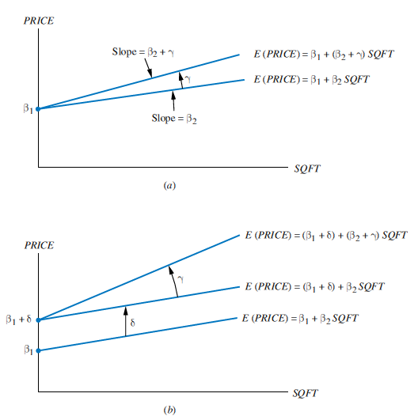
Indicator Variables
(a) A slope-indicator variable
(b) Slope- and intercept-indicator variables
Slope Indicator Variables

Slide 14
Indicator Variables
Slope and intercept Indicator Variables
If we believe that location affects both the intercept and the slope, then the model becomes:
Now we can see that:

Slide 15
Indicator Variables
The least squares estimator’s properties are not affected by the fact that one of the explanatory variables consists of only zeroes and ones
D is treated as any other explanatory variable.
We can construct the confidence interval for D, or test for its significance in the usual way.

Slide 16
Indicator Variables
An Example: The University Effect on House Prices
Suppose an economist specifies a regression equation for house prices as:

Slide 17
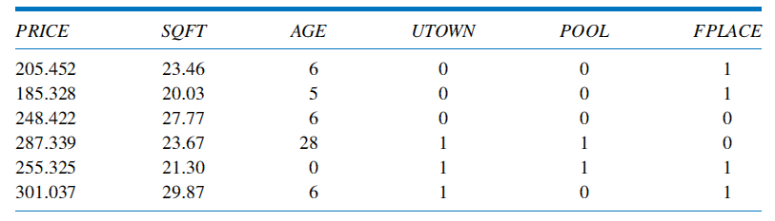
Indicator Variables
Representative Real Estate Data Values
An Example: The University Effect on House Prices

Slide 18
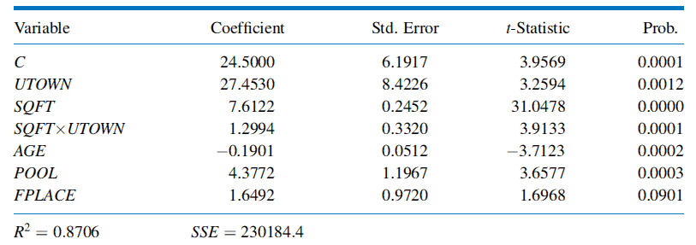
Indicator Variables
House Price Equation Estimates
An Example: The University Effect on House Prices

Slide 19
Indicator Variables
An Example: The University Effect on House Prices
We therefore estimate that:
The location premium for properties near the university is $27,453
The change in expected price per additional 100 square feet is $8912 for houses near the university and $7612 for houses in other areas
Houses depreciate $190.10 per year
A pool increases the value of a home by $4,377.20
A fireplace is not significant at 5%.

